Slide 1
CAPTSTONE FINAL PROJECT-Opening a SUPER FOOD shop @ Bangalore
Jaskaran Singh Attal
-jass.attal@gmail.com

Slide 2
Overview
Introduction
Business problem
Methodology
Data Collection
Neighborhood Geocoding
Visualizing Neighborhood
Venue Category filtering
One hot encoding
Top 10 common venues
K-means Clustering
Results
Discussion
Conclusion
Venue Data
Fitness Preference
Eating Habits

Slide 3
YOU ARE WHAT YOU EAT!!

Slide 4
Introduction
Using food as our medicine has become a popular theme for health improvement. The trend is now to focus on healthy food intake as a primary fitness goal.
Bangalore could become the fitness capital of our country. It has emerged as the most fitness conscious city in India followed by Delhi and Mumbai as per new findings. People are buying products related to fitness triple the times as compared to 2015 as per latest reports of Snapdeal.

Slide 5
Business Case
With the population 12 lakh and people and whooping 4350 people per square feet, the fitness centers are flooded everyday with the huge foot fall.
Identifying area where there are large fitness centers but not proper health juice and nutrition super food shop would an analysis of immense importance for people trying to identify areas best suited for this business.

Slide 6
Data Collection-Preliminary Research
A preliminary research on the type of fitness activity which is popular among the people .This would help to find out the footfall at various venues of the city.
A study on the habits of the Indian people. This would tell us the preferred cuisines and reasons of them eating out. This would help in finding venues preferred by people if they choose to eat outside

Slide 7
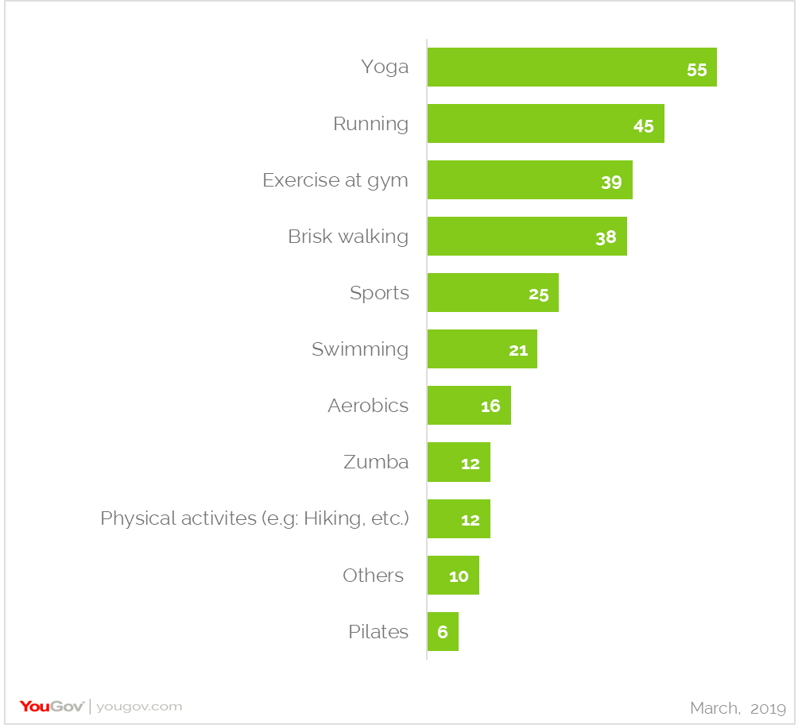
Data Collection-Fitness Preferences
Fig. Fitness preference
As per yougov.com majority of the fitness oriented population prefers to do Yoga, Running, Gym or Sports.
Therefore venues related to these activities become crucial for analysis

Slide 8
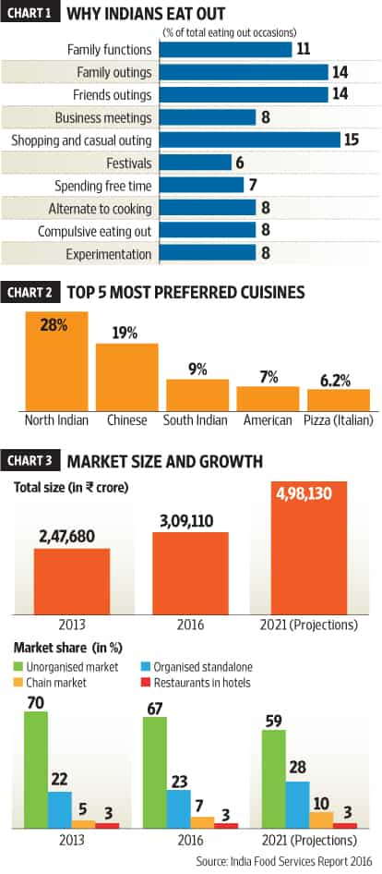
Data Collection-Eating habits
Fig. Eating preference
As per livemint.com group gatherings(with friends and family) and not cooking at home are top reasons for people to go out and eat. Group gathering place to be looked for in analysis
Major chunk of food market is unorganized. Food trucks etc. to be watched out
North Indian, Chinese and south Indians are the top performing cuisine for people to eat out

Slide 9
Data Collection – Neighbourhood Geo coding
The neighborhood data is scraped from a Mapsofindia.com webpage.
. The latitude and longitude of the neighborhoods are retrieved using Google Maps Geocoding API.

Slide 10
Data Collection –Venue Data
From the location data obtained after Web Scraping and Geocoding, the venue data is found out by passing in the required parameters to Foursquare API, and creating another Data Frame to contain all the venue details along with the respective neighbourhoods.

Slide 11
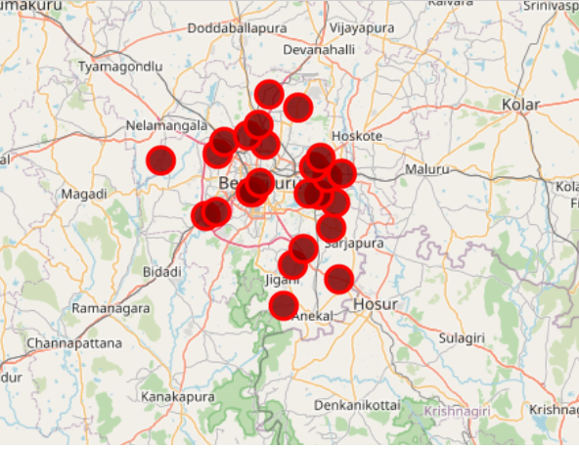
Methodology-Visualizing Neighborhood
The neighborhood data is scraped from a Mapsofindia.com webpage.
. The latitude and longitude of the neighborhoods are retrieved using Geopy package from python
Fig. Neighborhood marking with folium

Slide 12
Methodology-Venue Category Filtering
'Afghan Restaurant', | 'Australian Restaurant', | 'Bookstore', | 'Fitness GOTO area max', | 'Multiplex', | 'Hotel Bar',
'Airport', | 'BBQ Joint', | 'Botanical Garden', | 'Flea Market', | 'Music Store', | 'Ice Cream Shop',
'Airport Terminal', | 'Badminton Court', | 'Boutique', | 'Flower Shop', | 'Music Venue', | 'Indian Chinese Restaurant',
'American Restaurant', | 'Bagel Shop', | 'Bowling Alley', | 'Food', | 'Nightclub', | 'Indian Restaurant',
'Andhra Restaurant', | 'Bakery', | 'Breakfast Spot', | 'Food Court', | 'Noodle House', | 'Indian Sweet Shop',
'Arcade', | 'Bar', | 'Brewery', | 'Food Truck', | 'North Indian Restaurant', | 'Italian Restaurant',
'Art Gallery', | 'Basketball Court', | 'Bubble Tea Shop', | 'French Restaurant', | 'Office', | 'Japanese Restaurant',
'Art Museum', | 'Bed & Breakfast', | 'Building', | 'Fried Chicken Joint', | 'Park', | 'Juice Bar',
'Asian Restaurant', | 'Bike Shop', | 'Burger Joint', | 'Furniture / Home Store', | 'Performing Arts Venue', | 'Karnataka Restaurant',
'Athletics & Sports', | 'Bistro', | 'Burrito Place', | 'Garden Center', | 'Pizza Place', | 'Kerala Restaurant',
'Bus Station', | 'Coffee Shop', | 'Dessert Shop', | 'Gas Station', | 'Platform', | 'Lake',
'Business Service', | 'Concert Hall', | 'Dhaba', | 'Gastropub', | 'Plaza', | 'Liquor Store',
'Cafeteria', | 'Construction & Landscaping', | 'Dim Sum Restaurant', | 'General Entertainment', | 'Pool', | 'Lounge',
'Café', | 'Convenience Store', | 'Diner', | 'Go Kart Track', | 'Pub', | 'Maharashtrian Restaurant',
'Campground', | 'Cosmetics Shop', | 'Donut Shop', | 'Golf Course', | 'Racetrack', | 'Market',
'Castle', | 'Creperie', | 'Eastern European Restaurant', | 'Grocery Store', | 'Rajasthani Restaurant', | 'Mediterranean Restaurant',
'Chaat Place', | 'Cricket Ground', | 'Electronics Store', | 'Henan Restaurant', | 'Recreation Center', | "Men's Store",
'Chinese Restaurant', | 'Cupcake Shop', | 'Falafel Restaurant', | 'History Museum', | 'Resort', | 'Mexican Restaurant',
'Clothing Store', | 'Deli / Bodega', | 'Farmers Market', | 'Hockey Arena', | 'Restaurant', | 'Motorcycle Shop',
'Cocktail Bar', | 'Department Store', | 'Fast Food Restaurant', | 'Hotel', | 'Salad Place', | 'Movie Theater',
'Athletics & Sports', | 'Juice Bar',
'Badminton Court', | 'Lake',
'Basketball Court', | 'Lounge',
'Bed & Breakfast', | 'Market',
'Breakfast Spot', | 'North Indian Restaurant',
'Building', | 'Office',
'Bus Station', | 'Park',
'Chaat Place', | 'Pool',
'Chinese Restaurant', | 'Salad Place',
'Construction & Landscaping', | 'Sandwich Place',
'Cricket Ground', | 'Snack Place',
'Dhaba', | 'Soccer Field',
'Fast Food Restaurant', | 'Soccer Stadium',
'Fitness GOTO area max', | 'South Indian Restaurant',
'Food Court', | 'Sporting Goods Shop',
'Food Truck', | 'Stadium',
'Fried Chicken Joint', | 'Tech Startup',
'Furniture / Home Store', | 'Track Stadium',
'Hockey Arena', | 'Vegetarian / Vegan Restaurant',
'Hotel',
Fig. Narrowing down venue categories
The venue categories are then filtered on the basis of preliminary analysis and narrowed down to 39 instead of initial no. of 150.
The main factors filter considered are- Gym, Tracks, Sports related places, fast food areas, North Indian, Chinese and south Indian cuisines

Slide 13
Methodology-One hot encoding
One hot encoding
One hot encoding is a process by which categorical variables are converted into a form that could be provided to ML algorithms to do a better job in prediction. For the K-means Clustering Algorithm, all unique items under Venue Category are one-hot encoded.

Slide 14
Methodology-Top 10 Venues
Top 10 most common venues
Due to high variety in the venues, only the top 10 common venues are selected and a new Data Frame is made, which is used to train the K-means Clustering Algorithm.

Slide 15
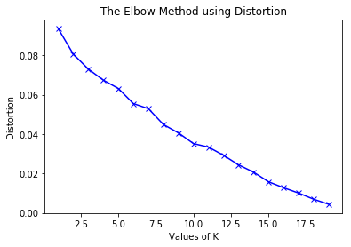
Methodology-Optimization Elbow method
Fig. Plot for K
Elbow method used to find out the optimal value of and the corresponding distortion. The first change point i.e. 6 is taken as the optimal value for K

Slide 16
Methodology-K-Means Cluster
K-means clustering
The venue data is then trained using K-means Clustering Algorithm to get the desired clusters to base the analysis on. K-means was chosen as the variables (Venue Categories) are huge, and in such situations K-means will be computationally faster than other clustering algorithms.

Slide 17
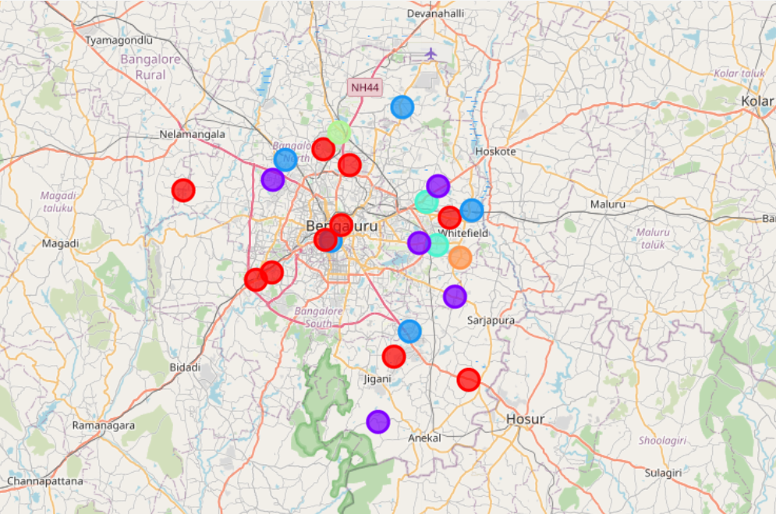
Results
Fig. Labels plot with help of folium
The neighborhoods are divided into n clusters where n is the number of clusters found using the optimal approach. The clustered neighborhoods are visualized using different colors so as to make them distinguishable.

Slide 18
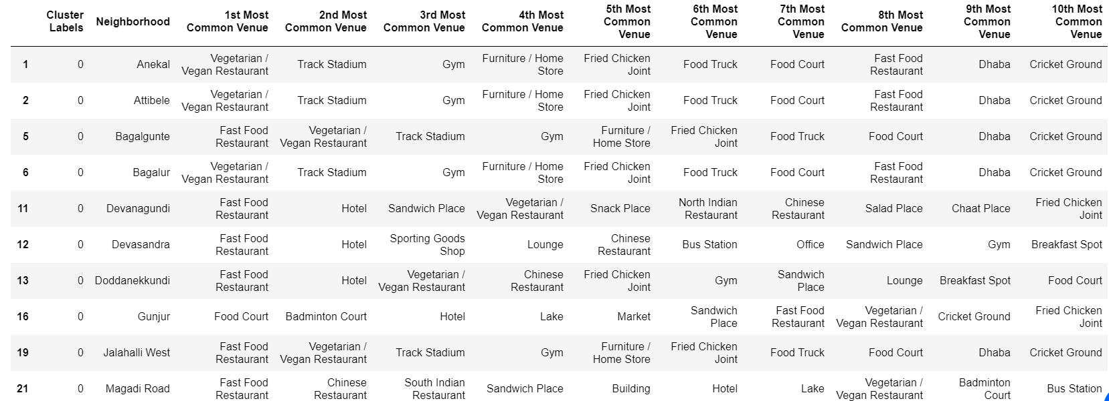
Discussion
Fig. 0 Cluster label top 10 venues
The 10 places namely Anekal, Attibele, Baglaur, Devansundra, Doddanekuddi, Gunjur, Jalahli West, Magdi Road fall in the criteria for abundant amount of fitness places and fast food places. This would give an ample opportunities to take business there.

Slide 19
Conclusion
As people get more and more aware about the relation between the food and fitness. There is a expected shift from people eating habits from unhealthy food to healthy food.
More data on demographics like age , area wise population density, income can be integrated to get narrow down to less options

Slide 20
THANK YOU!!

